Slide 1

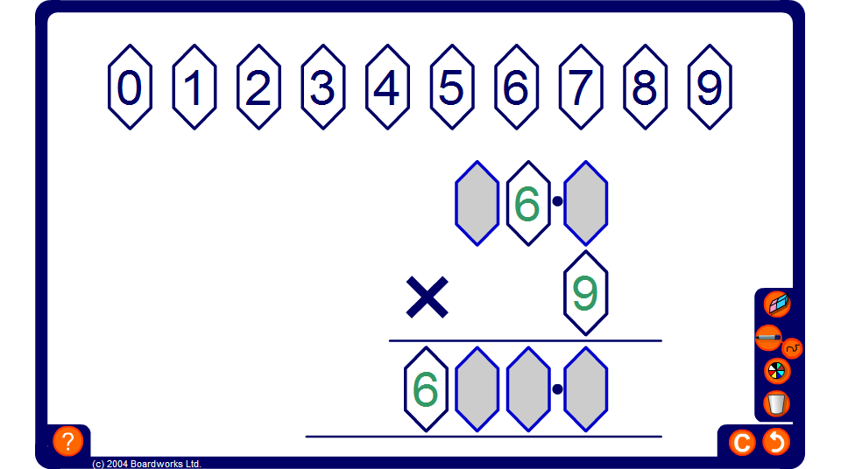


Drag and drop multiplication problem
Notes:
Ask pupils to fill in the remaining digits to make the sum correct.
For example, 9. × 3 = .2
Possible solutions are: 91.4 × 3 = 274.2, 92.4 × 3 = 277.2 and 93.4 × 3 = 280.2.

